Slide 1
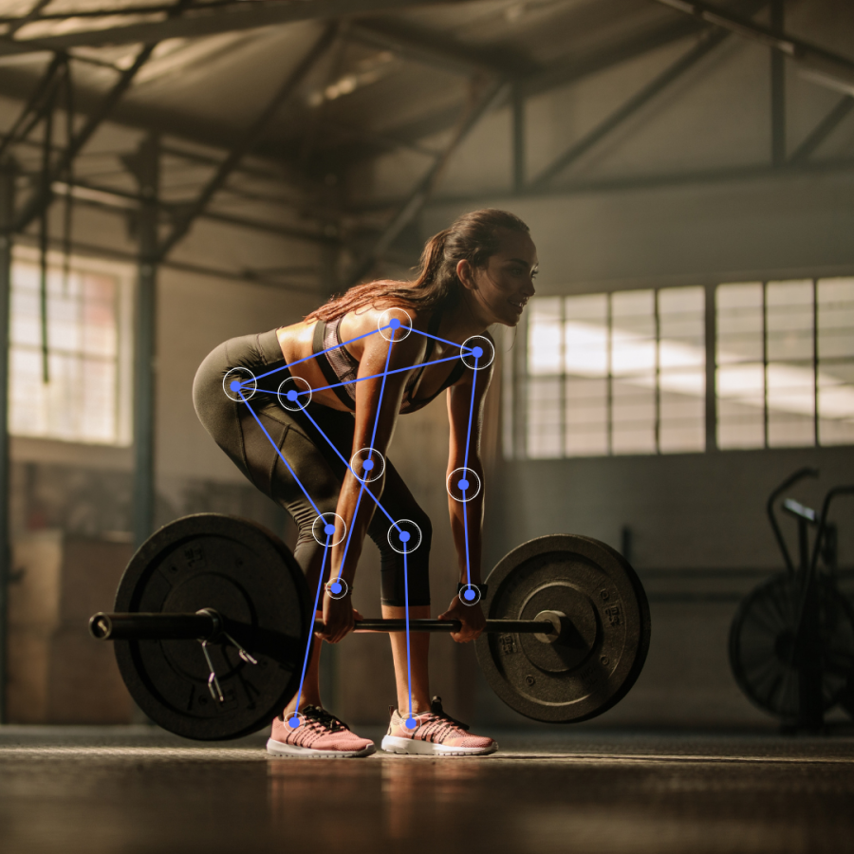
Politecnico di Milano
SCUOLA DI INGEGNERIA INDUSTRIALE E DELL’INFORMAZIONE
Master Degree in Biomedical Engineering
AI Gym Tracker
LABORATORY OF NEARABLE TECHNOLOGIES
FOR HEALTH DATA SCIENCE
Professors
Andrea Moglia
Marco Brando Paracchini
Coluccino Edoardo
Freddo Sara
Girolami Francesca
Vogel Hannes
a.a. 2024-2025

Slide 2

1. Background
TOWARDS SMARTER HEALTHCARE
Healthcare applications are rapidly evolving, especially with the integration of wearable technologies and computer vision systems.
OUR IDEA
user-friendly app
every-day instruments usage
personalized
low-cost
everywhere monitoring
Page 3
Politecnico di Milano – Scuola di Ingegneria Industriale e dell’Informazione, Master Degree in Biomedical Engineering
Coluccino Edoardo, Freddo Sara, Girolami Francesca, Vogel Hannes
Notes:
Healthcare applications are rapidly evolving, especially with the integration of wearable technologies and computer vision systems. In this context, having an app capable of monitoring and evaluating physical exercise execution is becoming increasingly relevant, both for personal fitness and rehabilitation purposes.
For this reason, the idea was to create a user-friendly web app which could help people in doing correct exercises also in absence of an instructor, just using common every-day objects, like cameras. In this way, a personalized, low-cost and everywhere monitoring is possible.

Slide 3
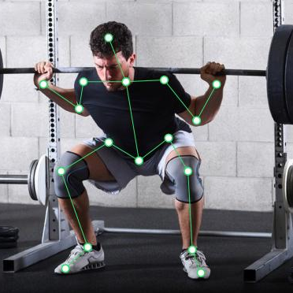
2. Aim of the work
AIM OF OUR WORK
Design and implement a computer vision-based system which can:
Recognize and classify physical exercises using video data from a camera
Differentiate between similar exercises to ensure accurate activity recognition
Evaluate the quality of exercise execution, providing feedback to help improve form and prevent injury
Page 4
Politecnico di Milano – Scuola di Ingegneria Industriale e dell’Informazione, Master Degree in Biomedical Engineering
Coluccino Edoardo, Freddo Sara, Girolami Francesca, Vogel Hannes
Notes:
So, the aim of our work was to design and implement a computer vision-based system that can:
Recognize and classify different physical exercises from videos acquired with a camera
Differentiate between similar exercise types to ensure accurate activity recognition
Evaluate the quality of exercise execution, providing feedback to help improve form and prevent injury.

Slide 4
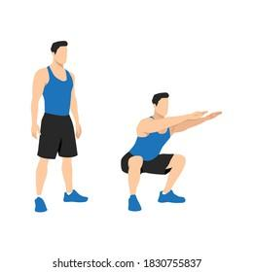
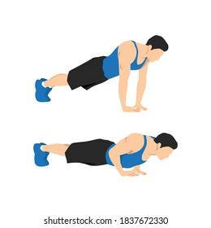
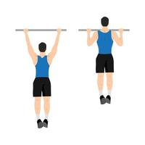
2. Aim of the work
TASK 1 - Distinguish three different physical exercises
Squat Push up Pull up
Page 5
Politecnico di Milano – Scuola di Ingegneria Industriale e dell’Informazione, Master Degree in Biomedical Engineering
Coluccino Edoardo, Freddo Sara, Girolami Francesca, Vogel Hannes

Slide 5
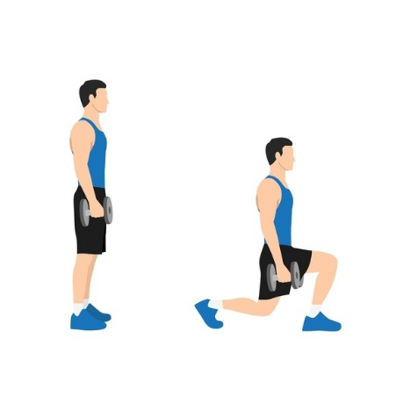
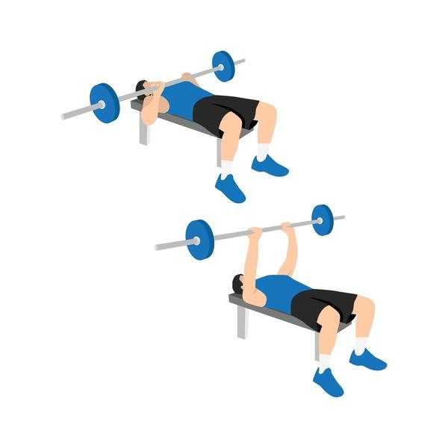
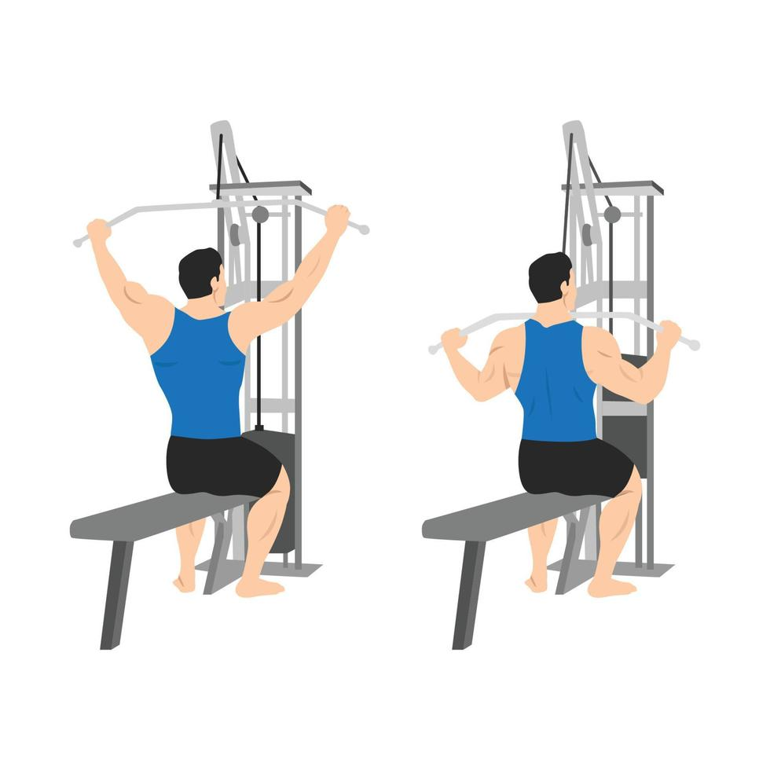
2. Aim of the work
TASK 2 - Distinction of the 3 previous physical exercises from 3 similar exercises
Split squat Bench press Lat pull down
Page 6
Politecnico di Milano – Scuola di Ingegneria Industriale e dell’Informazione, Master Degree in Biomedical Engineering
Coluccino Edoardo, Freddo Sara, Girolami Francesca, Vogel Hannes

Slide 6





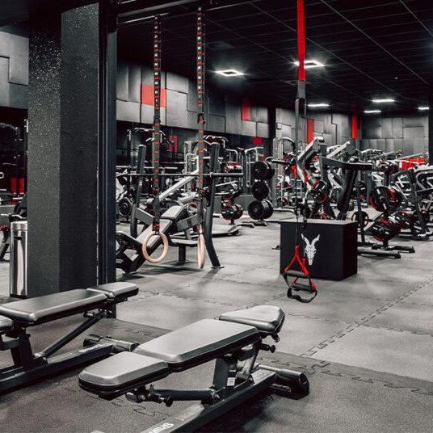

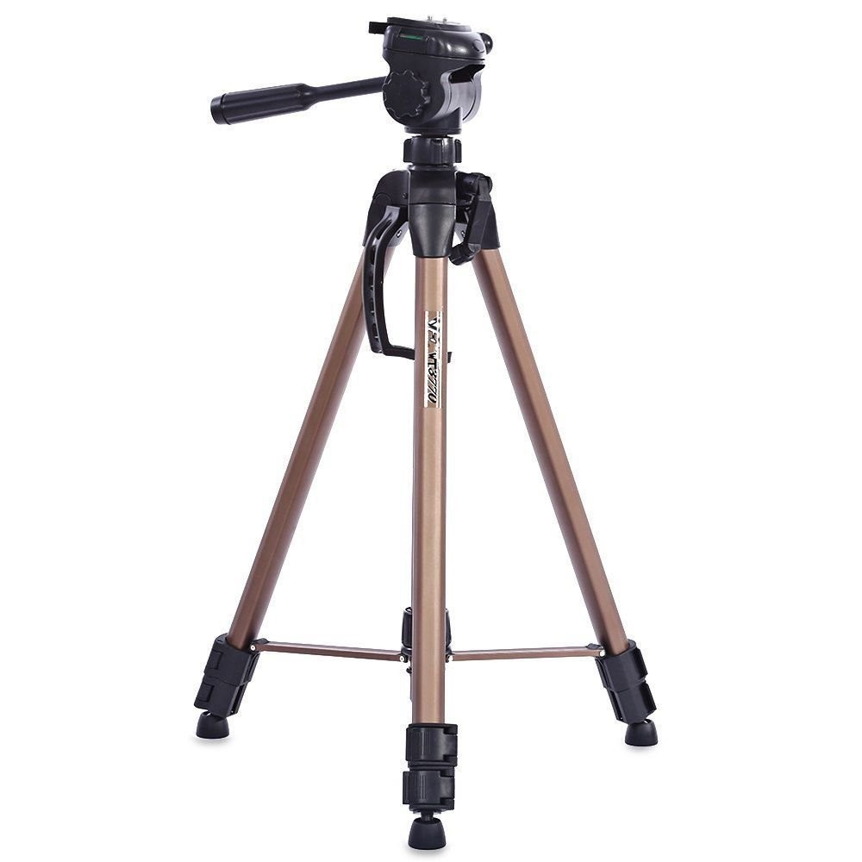



3. Tools
Page 8
Politecnico di Milano – Scuola di Ingegneria Industriale e dell’Informazione, Master Degree in Biomedical Engineering
Coluccino Edoardo, Freddo Sara, Girolami Francesca, Vogel Hannes

Slide 7



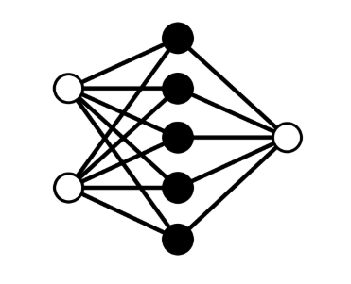



4. Project Development
Data Acquisition
Methods
Preprocessing
Dataset & Model
Results
Quality evaluation
Web App
Page 9
Notes:
For our development we’ll follow 7 different phases:
Firstly we aquired our data during a gym session of our Personal Trainers, then we descussed about the methods to deal with our tasks. We prepared data in order to give them as input to our models ad algorithms of which we will see the results. One of the last steps is the quality evaluation of the performed exercise and finally the user interface development.

Slide 8


Data acquisition
Chosen setup for video recordings on professional athletes (Personal Trainers) of correctly performed exercises.
Multiple angles
(higher amount of data)
Higher generalization capability
Greater level of freedom for the user
Page 10
Politecnico di Milano – Scuola di Ingegneria Industriale e dell’Informazione, Master Degree in Biomedical Engineering
Coluccino Edoardo, Freddo Sara, Girolami Francesca, Vogel Hannes
Notes:
This is our idea of setup to acquire video data from different point of view simultaneously. The basic concept is that a general user should not be forced to a specific positioning of the camera, so the more data we are able to acquire, the higher will be the generalization capability of the model used for the classification and so the greater is the freedom of the user.

Slide 9

Data acquisition
Chosen setup for video recordings on professional athletes (Personal Trainers) of correctly performed exercises.
Issues:
Missing instrumentation
Free space around the athlete
Page 11
Politecnico di Milano – Scuola di Ingegneria Industriale e dell’Informazione, Master Degree in Biomedical Engineering
Coluccino Edoardo, Freddo Sara, Girolami Francesca, Vogel Hannes
Notes:
Due to our specific situation at the gym we decided to use only two cameras.

Slide 10

Data acquisition
Chosen setup for video recordings on professional athletes (Personal Trainers) of correctly performed exercises.
Final setup
Page 12
Politecnico di Milano – Scuola di Ingegneria Industriale e dell’Informazione, Master Degree in Biomedical Engineering
Coluccino Edoardo, Freddo Sara, Girolami Francesca, Vogel Hannes
Notes:
So this is our final setup.

Slide 11
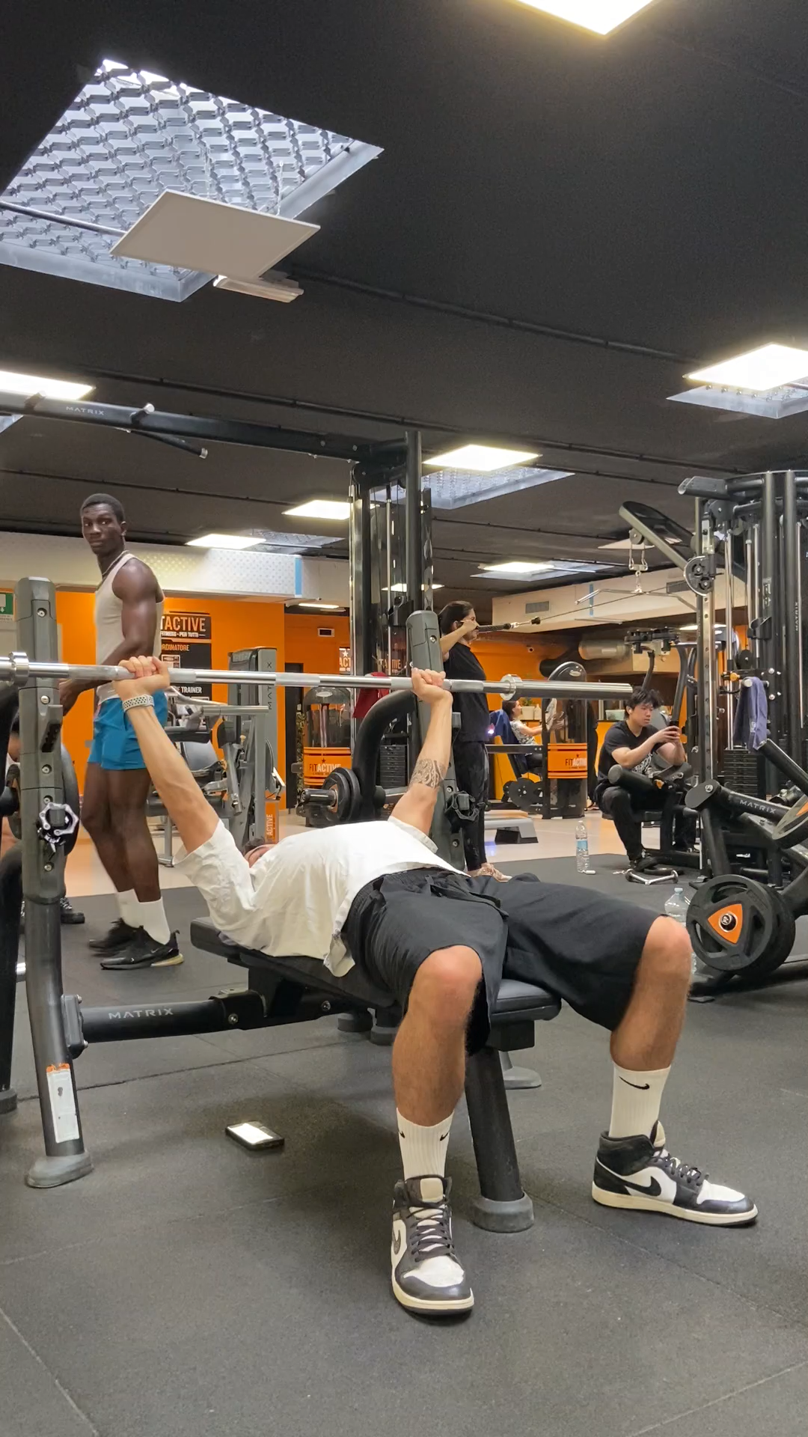
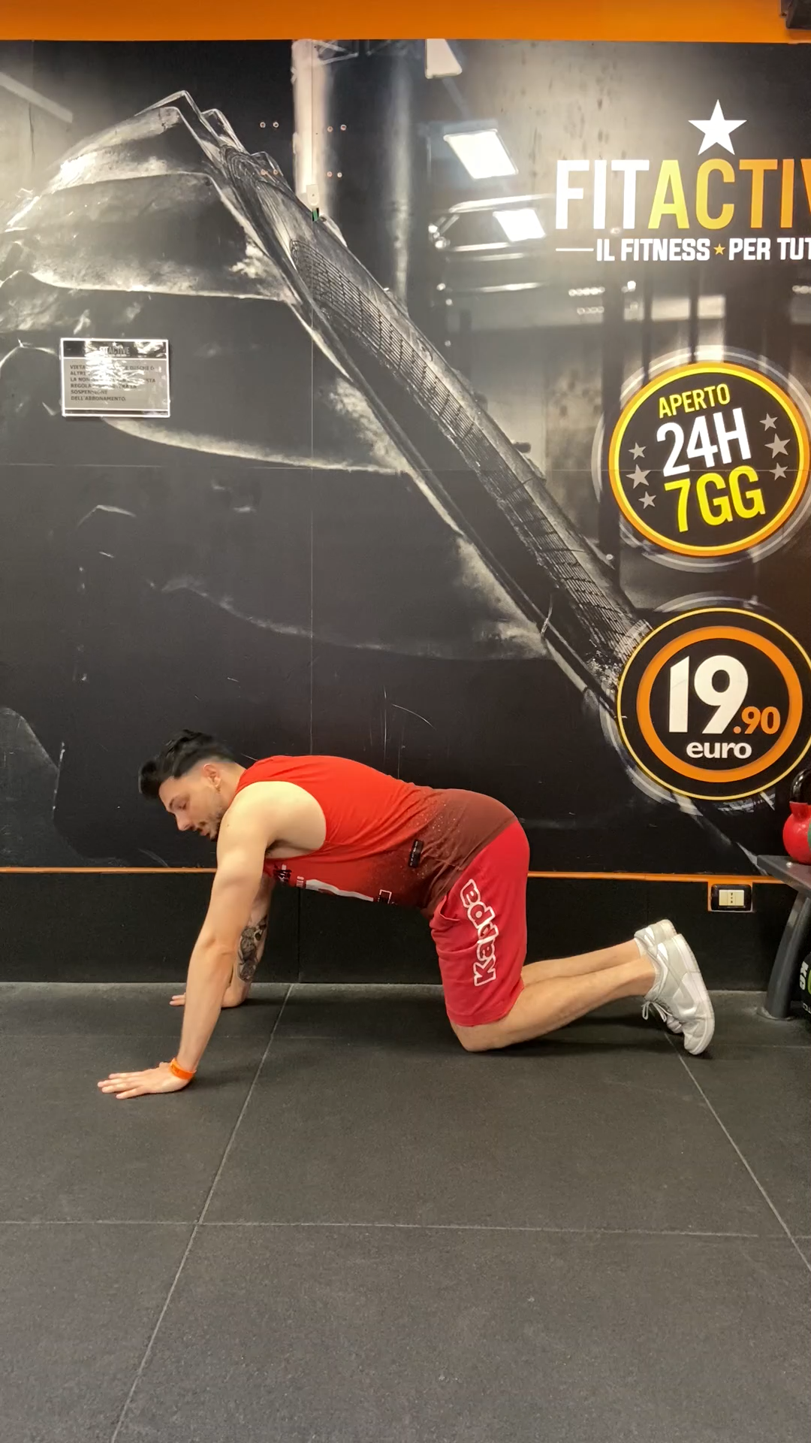
Data acquisition
Detection on different subjects of all the 6 exercises to increase the robustness of the model.
+ Online datasets have been added to enlarge our dataset, increase the robustness of the model and avoid overfitting, but some exercises where missing.
Page 13
Politecnico di Milano – Scuola di Ingegneria Industriale e dell’Informazione, Master Degree in Biomedical Engineering
Coluccino Edoardo, Freddo Sara, Girolami Francesca, Vogel Hannes
Notes:
We acquired data on different subjects to avoid overfitting and added online dataset we found.

Slide 12
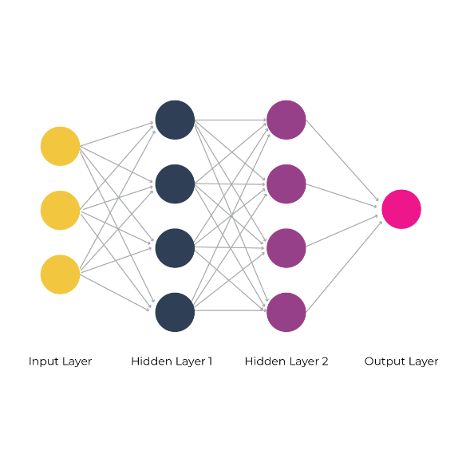

Methods
STEP 1
A deep learning model classify which of the 6 exercises the subject is performing.
Multiclass classification problem
Input: CSV files
Output: 0-5 class
STEP 2
A rule-based algorithm gives a feedback about the quality of the execution/corrections.
It uses different parameters starting from the classified exercise given as output from the deep learning model.
Page 14
Politecnico di Milano – Scuola di Ingegneria Industriale e dell’Informazione, Master Degree in Biomedical Engineering
Coluccino Edoardo, Freddo Sara, Girolami Francesca, Vogel Hannes
Notes:
Our method to deal with our tasks is composed by two steps, the first is a deep learning model to deal with a multiclass classification problem so the exercises recognition and discrimination. Then the second step for the quality evaluation is a rule-based algorithm which takes into account different parameters for each exercise and gives a feedback as output.

Slide 13
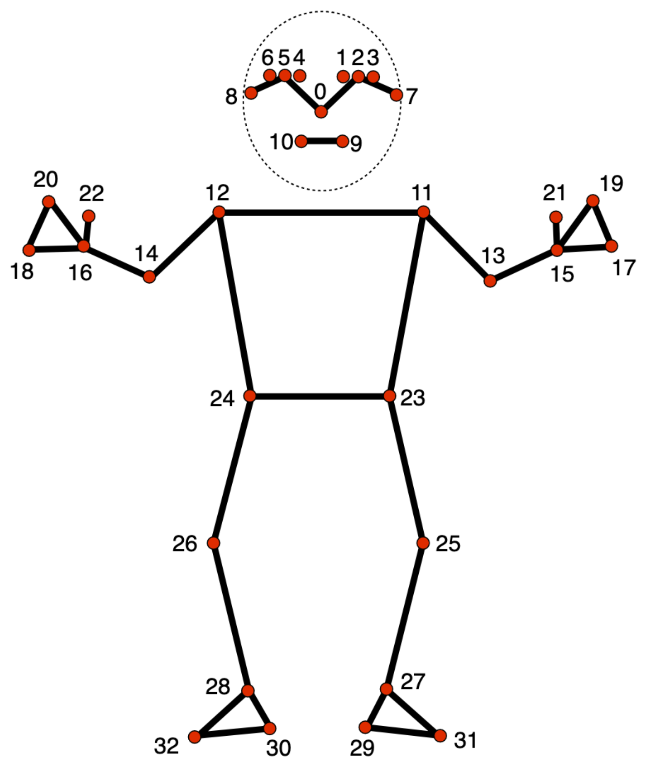


Preprocessing
From video recordings to CSV files.
Cleaning phase
Skeleton extraction
Landmarks coordinates files
Page 15
Politecnico di Milano – Scuola di Ingegneria Industriale e dell’Informazione, Master Degree in Biomedical Engineering
Coluccino Edoardo, Freddo Sara, Girolami Francesca, Vogel Hannes
Notes:
About the preprocessing we cleaned up our data, cutting the death and unuseful parts. Then from the good data we extracted a skeleton of the person from each frame and finally we created every 30 frames a CSV file containing all the landmarks coordinates and the label from 0 to 5 for the 6 classes. CSV files have been saved subdivided into 6 folders one for each exercise.
Cut dei video per pulizia da parti morte
Estrazione dello scheletro per singolo frame con Mediapipe modello già esistente ed allenato
Ogni frame occupa una riga del CSV -> 132 coordinate dei landmarks
Ultima colonna aggiunta è il label – esercizi numerati da 0 a 5
Otteniamo diversi CSV ciascuno da 30 frames salvati in 6 cartelle una per esercizio
Classificazione

Slide 14
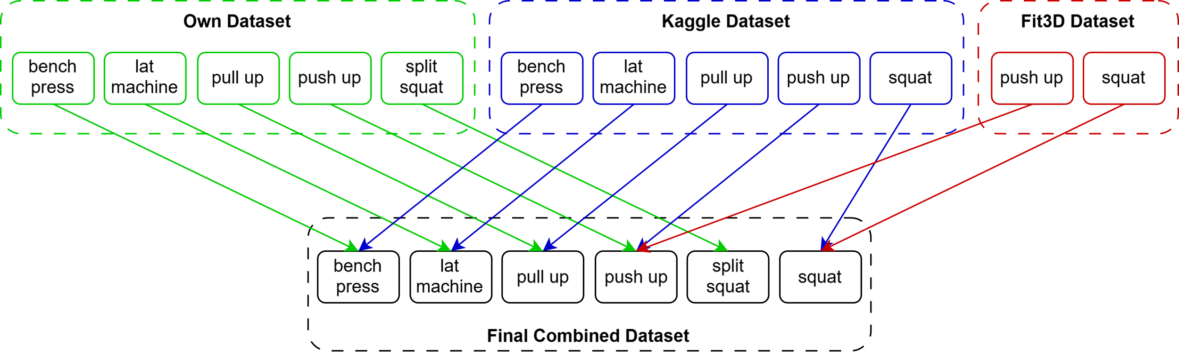
Final Dataset
Page 16
Politecnico di Milano – Scuola di Ingegneria Industriale e dell’Informazione, Master Degree in Biomedical Engineering
Coluccino Edoardo, Freddo Sara, Girolami Francesca, Vogel Hannes

Slide 15
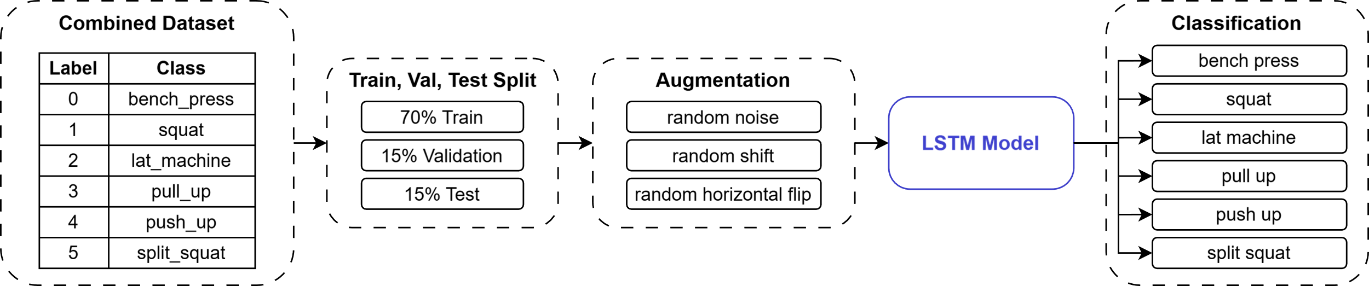
Proposed Pipeline
Page 16
Politecnico di Milano – Scuola di Ingegneria Industriale e dell’Informazione, Master Degree in Biomedical Engineering
Coluccino Edoardo, Freddo Sara, Girolami Francesca, Vogel Hannes

Slide 16
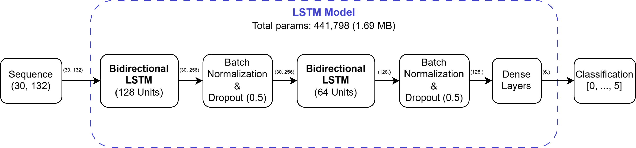
Proposed Model
Page 16
Politecnico di Milano – Scuola di Ingegneria Industriale e dell’Informazione, Master Degree in Biomedical Engineering
Coluccino Edoardo, Freddo Sara, Girolami Francesca, Vogel Hannes

Slide 17
Results
99% Accuracy
on the final Test Set
Minor Errors & Split Squat Confusion for the 6-Class Model
Robust Real-Time
3-Class Model Classification
Areas of
Improvements remain
Page 17
Politecnico di Milano – Scuola di Ingegneria Industriale e dell’Informazione, Master Degree in Biomedical Engineering
Coluccino Edoardo, Freddo Sara, Girolami Francesca, Vogel Hannes

Slide 18
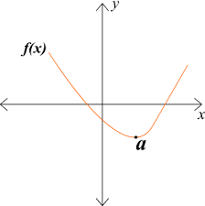
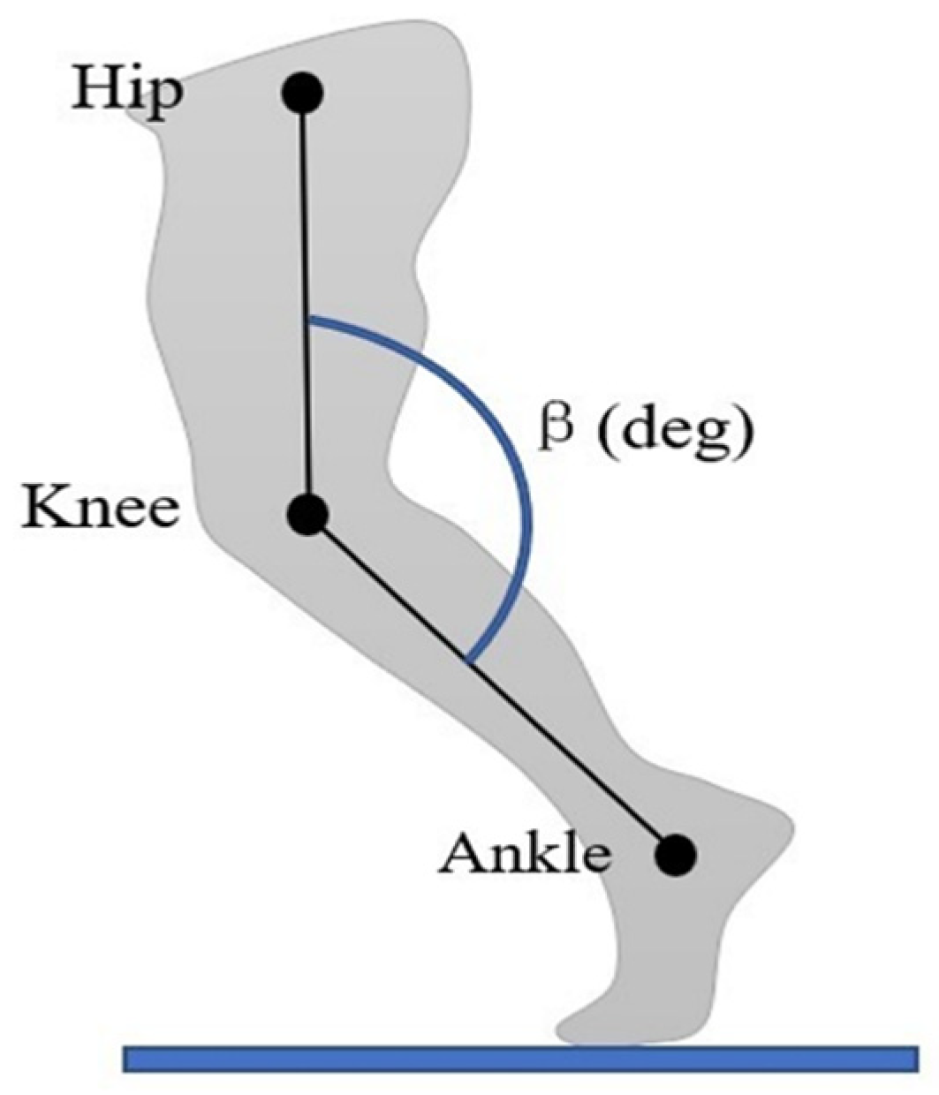
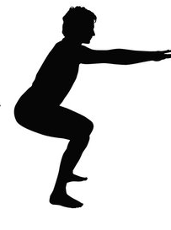
Quality Evaluation
Rule based algorithm
Function 2 - trends evaluation and local minimum computation
Function 3 - general function which make the evaluation through pre-set threshold values.
Function 1 - angle
computation
Page 18
Politecnico di Milano – Scuola di Ingegneria Industriale e dell’Informazione, Master Degree in Biomedical Engineering
Coluccino Edoardo, Freddo Sara, Girolami Francesca, Vogel Hannes
Notes:
Algoritmo Rule Based:
Funzione 1 – calcola gli angoli tra 3 landmarks utili
Funzione 2 – calcola il minimo locale tra 3 frames consecutivi per quell’angolo che analizzo nel tempo
Funzione principale di analisi – sono state impostate delle soglie da verificare, per esempio angolo tra caviglia anca e ginocchio deve raggiungere un valore inferiore a 90° per poter essere considerata una buona esecuzione. Un altro tipo di soglia è la posizione per esempio del ginocchio ripetto alla punta del piede verificando la posizione reciproca delle coordinate dei landmarks di interesse. È stata impostata una doppia soglia per creare la banda di esecuzione scorretta dell’esercizio: se sto sopra l’algoritmo non rileva il movimento, se sto sotto l’esecuzione è corretta, se ci sono dentro e l’algoritmo rileva un minimo locale, allora l’esecuzione è scorretta.

Slide 19


Web App
FRONTEND
BACKEND
HTML / CSS / JS
Python
HEAD
MediaPipe Library
CSS styles
BODY
Camera selection and video acquisition
Mediapipe skeleton representation
Frame acquisition and processing
Rule-based algorithms
Real-time feedback management
Auxiliary functions and reports
Process acquired data in the frontend
Exercise classification model
Frontend/BackEnd communication protocols
Page 20
Politecnico di Milano – Scuola di Ingegneria Industriale e dell’Informazione, Master Degree in Biomedical Engineering
Coluccino Edoardo, Freddo Sara, Girolami Francesca, Vogel Hannes

Slide 20
Web App
JSON:
Two-dimensional array (30x132)
FRONTEND
BACKEND
Data TRANSMISSION
And
TRANSFORMATION
JSON:
Classified movement
Data reshaping
(3D tensor)
CLASSIFICATION
Page 22
Politecnico di Milano – Scuola di Ingegneria Industriale e dell’Informazione, Master Degree in Biomedical Engineering
Coluccino Edoardo, Freddo Sara, Girolami Francesca, Vogel Hannes

Slide 21
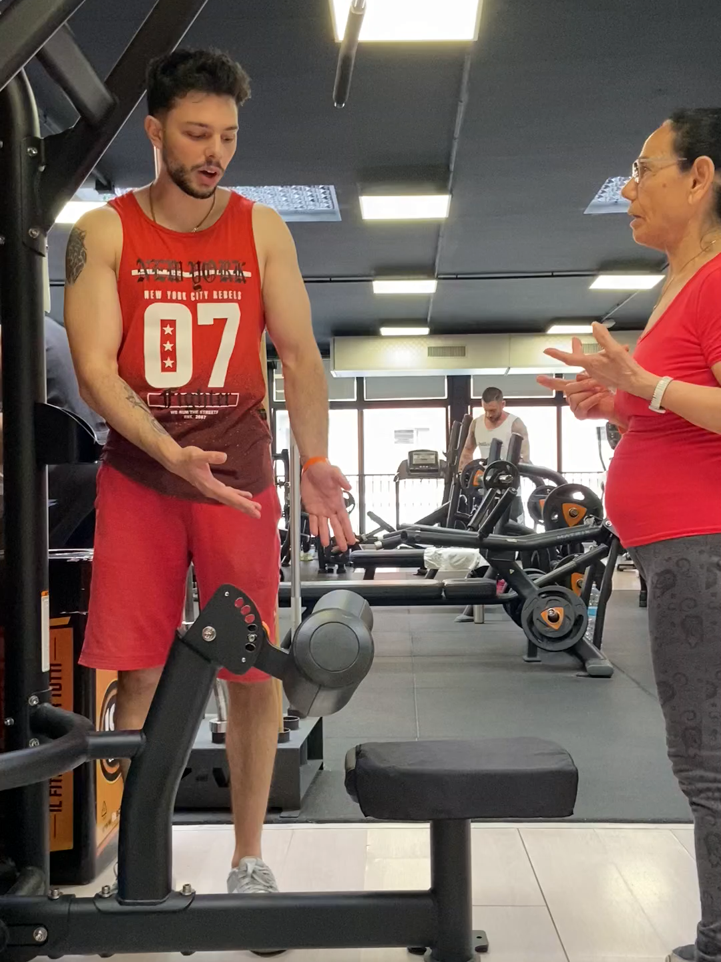
5. Limitations
Video acquisition quality
Joints extraction accuracy
Limited dataset
We had to change some exercises along the way and then used online dataset/make data augmentations
Page 26
Politecnico di Milano – Scuola di Ingegneria Industriale e dell’Informazione, Master Degree in Biomedical Engineering
Coluccino Edoardo, Freddo Sara, Girolami Francesca, Vogel Hannes
Notes:
- Gym with people going around, many tools and space limitation that confuse reduce the quality of the shots because it is more difficult to recognize the person from the rest
- Oversize clothes of people who have performed the exercises confused the position of the joints to be extracted
- Few repetitions of the exercises - overfitting
- We had to change some exercises along the way and then used online dataset

Slide 22
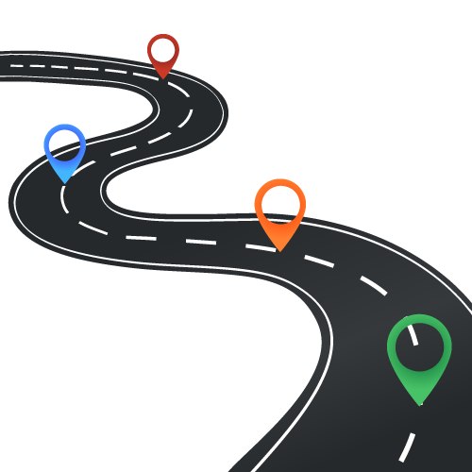
6. Future developments
A larger dataset is needed to make the model more robust - more repetitions and more subjects
3D reconstruction from multiple point of view
A more accurate model for the skeleton extraction
Enhance the number of physical exercises that the model can recognize and discriminate
Increase the number of parameters for a more complete quality evaluation
Improve the DL Model
Page 27
Politecnico di Milano – Scuola di Ingegneria Industriale e dell’Informazione, Master Degree in Biomedical Engineering
Coluccino Edoardo, Freddo Sara, Girolami Francesca, Vogel Hannes
Notes:
A larger dataset is needed to make the model more robust and avoid overfitting
3D reconstruction from multiple point of view - in order not to bind the user to a positioning of the webcam with a specific angle but where he/she prefers
A more accurate model for the skeleton extraction
Enhance the number of physical exercises that the model can recognize and discriminate
Increase the number of parameters for a more complete quality evaluation

Slide 23
Index
Background and aim of the work
Goals - 3 tasks
Tools
Project development
Data acquisition
Methods
Preprocessing
Chosen models
Results
Quality evaluation
Web app
Demo
Limitations
Future developments
Politecnico di Milano - Scuola di Ingegneria Industriale e dell’Informazione, Master Degree in Biomedical Engineering
Coluccino Edoardo, Freddo Sara, Girolami Francesca, Vogel Hannes

Slide 24
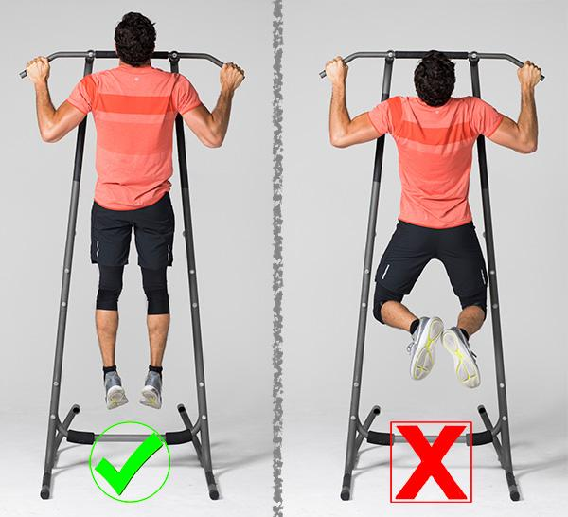
2. Goals
TASK 3 - Quality evaluation
Page 7
Politecnico di Milano – Scuola di Ingegneria Industriale e dell’Informazione, Master Degree in Biomedical Engineering
Coluccino Edoardo, Freddo Sara, Girolami Francesca, Vogel Hannes

Slide 25

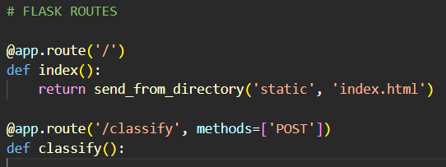
Web App
FRONTEND
BACKEND
Communication
protocol
Page 21
Politecnico di Milano – Scuola di Ingegneria Industriale e dell’Informazione, Master Degree in Biomedical Engineering
Coluccino Edoardo, Freddo Sara, Girolami Francesca, Vogel Hannes

Slide 26
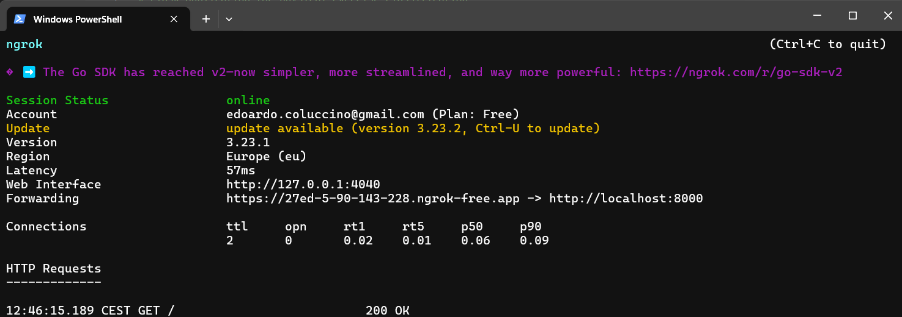
Web App
Ngrok - to make the WebApp accessible remotely
Page 24
Politecnico di Milano – Scuola di Ingegneria Industriale e dell’Informazione, Master Degree in Biomedical Engineering
Coluccino Edoardo, Freddo Sara, Girolami Francesca, Vogel Hannes

Slide 27

5. Demo
Page 25
Politecnico di Milano – Scuola di Ingegneria Industriale e dell’Informazione, Master Degree in Biomedical Engineering
Coluccino Edoardo, Freddo Sara, Girolami Francesca, Vogel Hannes

Slide 28
Thanks for your attention!
Politecnico di Milano – Scuola di Ingegneria Industriale e dell’Informazione, Master Degree in Biomedical Engineering
Coluccino Edoardo, Freddo Sara, Girolami Francesca, Vogel Hannes
Notes:
A larger dataset is needed to make the model more robust and avoid overfitting
3D reconstruction from multiple point of view - in order not to bind the user to a positioning of the webcam with a specific angle but where he/she prefers
A more accurate model for the skeleton extraction
Enhance the number of physical exercises that the model can recognize and discriminate
Increase the number of parameters for a more complete quality evaluation

Slide 29
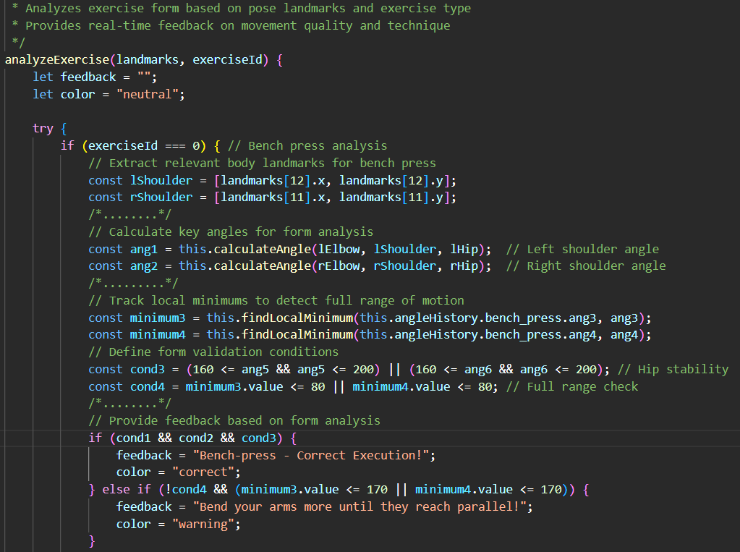
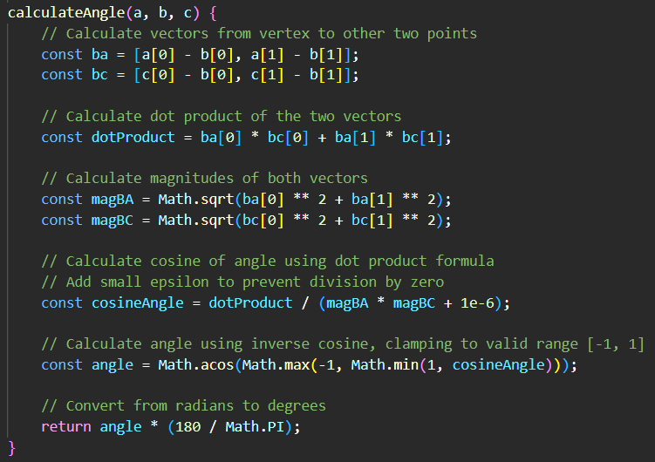
Quality Evaluation
Abstract operation
Rule Based Algorithm
Angles computation
Page 19
Politecnico di Milano – Scuola di Ingegneria Industriale e dell’Informazione, Master Degree in Biomedical Engineering
Coluccino Edoardo, Freddo Sara, Girolami Francesca, Vogel Hannes
Notes:
Algoritmo Rule Based:
Funzione 1 – calcola gli angoli tra 3 landmarks utili
Funzione 2 – calcola il minimo locale tra 3 frames consecutivi per quell’angolo che analizzo nel tempo
Funzione principale di analisi – sono state impostate delle soglie da verificare, per esempio angolo tra caviglia anca e ginocchio deve raggiungere un valore inferiore a 90° per poter essere considerata una buona esecuzione. Un altro tipo di soglia è la posizione per esempio del ginocchio ripetto alla punta del piede verificando la posizione reciproca delle coordinate dei landmarks di interesse. È stata impostata una doppia soglia per creare la banda di esecuzione scorretta dell’esercizio: se sto sopra l’algoritmo non rileva il movimento, se sto sotto l’esecuzione è corretta, se ci sono dentro e l’algoritmo rileva un minimo locale, allora l’esecuzione è scorretta.

Slide 30
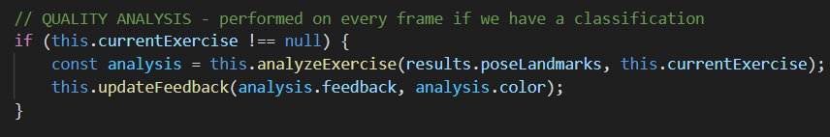
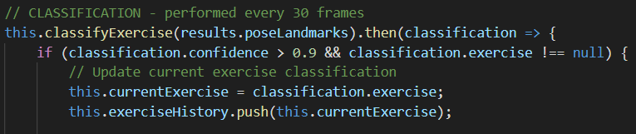
Web App
Asynchronous operation between Classification and Rule Based Algorithm
Each frame
Every 30 frames
Page 23
Politecnico di Milano – Scuola di Ingegneria Industriale e dell’Informazione, Master Degree in Biomedical Engineering
Coluccino Edoardo, Freddo Sara, Girolami Francesca, Vogel Hannes

